Slide 1
Samizdat lessons: three dimensions of the politics of self-publishing
Endre Dányi
Goethe University and Mattering Press
www.matteringpress.org
‘Disrupting the Humanities’ seminar
Coventry University, 7 March 2014

Slide 2

STS and .

Slide 3
Samizdat histories

Slide 4


Slide 5
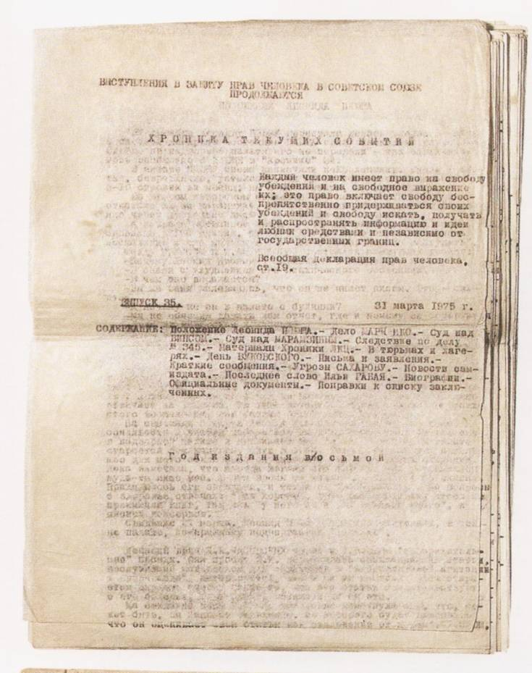

Slide 6


Slide 7
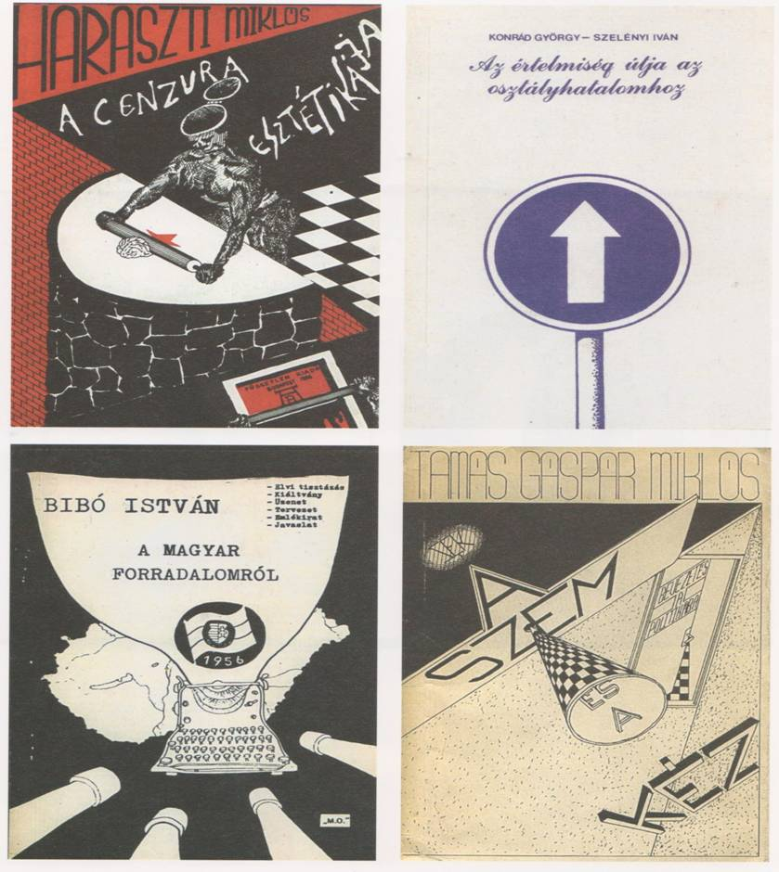

Slide 8
Three dimensions: materiality

Slide 9
‘The amateur typescript, the deformity of the text, the characteristic mistakes, corrections, fragile paper, and degraded print quality had value because they marked the difference between samizdat and official publications.’
Komaromi, A. (2004) The Material Existence of Soviet Samizdat’, Slavic Review, Vol. 63, No. 3, p. 609.

Slide 10
Three dimensions: experimentation

Slide 11
‘Dissidents questioned not so much the principles of the existing political order but rather their implementation. For the majority, the issue was not whether socialism was feasible at all; it was too real to have any doubts about its existence. Instead, to quote the title of an influential samizdat article, the main question was: “Is a nontotalitarian [sic!] type of socialism possible?” ’
Oushakine, S. A. (2001) ‘The Terrifying Mimicry of Samizdat’, Public Culture, Vol. 13, No 2, p. 199.

Slide 12
Three dimensions: the ethics of openness

Slide 13
The Jargon File (http://samizdat.info/):
‘[Samizdat] originally referred to underground duplication and distribution of banned books in the Soviet Union; now refers by obvious extension to any less-than-official promulgation of textual material, esp. rare, obsolete, or never-formally-published computer documentation.’

Slide 14
http://www.nongnu.org/samizdat/:
‘Samizdat is a generic RDF-based engine for building collaboration and open publishing web sites. Samizdat provides users with means to cooperate and coordinate on all kinds of activities, including media activism, resource sharing, education and research, advocacy, and so on. Samizdat intends to promote values of freedom, openness, equality, and cooperation.’

Slide 15
Mattering…

Slide 16
‘…is to take on the erasing process as the central human behaviour of concern, and then to track that comparatively across domains. This is, in the end, a profoundly political process, since so many form of social control rely on the erasure or silencing of various workers, on deleting their work from representations of the work.’
Star, S.L. (1991) ‘The sociology of the invisible’, in Maine (Ed.) Social organisation and social process, p. 281.

Slide 17
‘…proposes not so much a new definition of truth as a method of experimentation, or a construction for new truths. To experiment is to consider theory as a creative practice. This is why it is no longer a question of knowing what is true, but how truth comes about.’
William James, quoted in Sengers, I. (2011) Thinking with Whitehead, Harvard University Press, p. 251.

Slide 18
‘…is a process: it does not have clear boundaries. It is open-ended. This is not a matter of size; it does not mean that a care process is larger, more encompassing, than the devices and activities that are a part of it. Instead, it is a matter of time. For care is not a (small or large) product that changes hands, but a matter of various hands working together (over time) towards a result. Care is not a transaction in which something is exchanged (a product against a price); but an interaction in which the action goes back and forth (in an ongoing process).’
Mol, A. (2008) The Logic of Care: Health and the Problem of Patient Choice, Routledge, p. 18.

Slide 19
Thanks for your attention!

